Slide 1


Agriculture Commodity Price Forecasting Using Python
Department of Computer Science and Business Systems
Harish Raj S
Hari Rudhran M

Slide 2
INTRODUCTION
Agriculture Commodity Price Forecasting plays a crucial role in enhancing decision-making for farmers, traders, policymakers, and agribusinesses. Price fluctuations in agricultural commodities can significantly affect the economy and livelihood of millions, especially in agriculture-driven countries like India. With the increasing availability of historical market data and weather conditions, forecasting future prices has become more feasible and accurate through data-driven models.

Slide 3
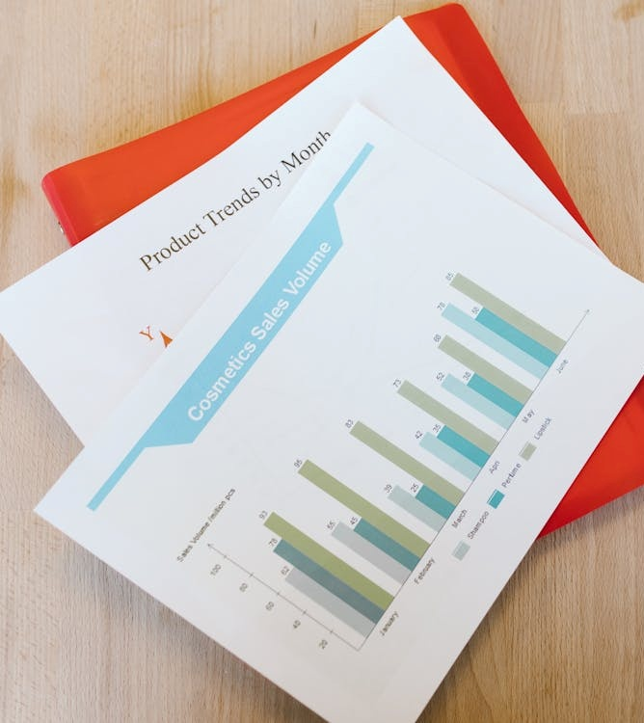
Aim of Project
The aim of this project is to develop a reliable and efficient forecasting system using Python that can predict future prices of agricultural commodities based on historical data. By leveraging time series analysis techniques such as ARIMA and SARIMA, the project seeks to identify market trends and seasonal patterns. This will assist farmers, traders, and policymakers in making data-driven decisions related to production planning, inventory management, and market strategies, ultimately helping to reduce the risks associated with price fluctuations in the agricultural sector.

Slide 4

Data Collection
Historical price data of various agricultural commodities was collected from reliable sources such as government agriculture portals, market committees, and open data platforms. The dataset typically includes daily or monthly prices of commodities like rice, wheat, maize, and pulses, recorded over several years. In some cases, additional factors like weather data, seasonality, and market demand may also be considered to enhance forecasting accuracy. The collected data is organized in Excel format and preprocessed using Python libraries like Pandas to ensure it is clean, consistent, and ready for time series analysis.

Slide 5

Data Preprocessing
The foundation of any forecasting model is high-quality data. Data can be collected from multiple sources such as public datasets. The accuracy of predictions largely depends on the quality and granularity of the collected data. Once acquired, the data undergoes preprocessing to ensure it is clean, structured, and usable for modeling. Preprocessing involves:
Handling Missing Values: Missing data points can significantly impact model performance. Methods such as forward/backward filling, interpolation, or statistical imputation help address this issue.
Normalization and Scaling: Rescaling data using Min-Max scaling or Standardization ensures that different time series attributes are comparable.
Resampling and Frequency Adjustment: Depending on the problem, time series data may need to be converted to different frequencies, such as daily, weekly, or monthly, to capture long-term trends.

Slide 6
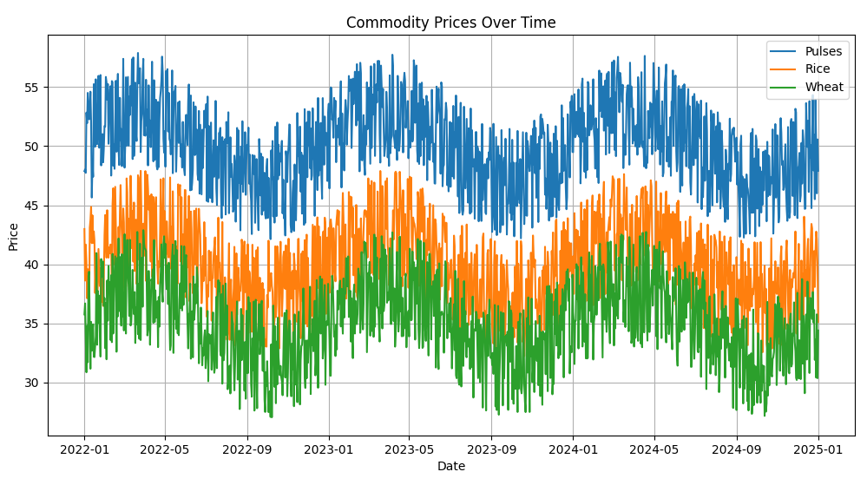
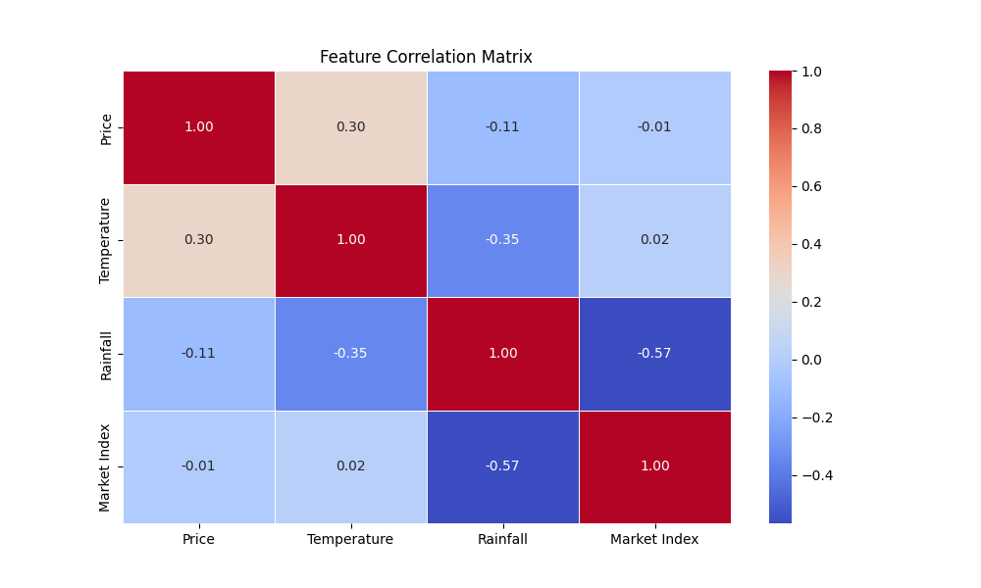
Visualizing Time Series Data
Visualizing Time Series Data is a crucial step that helps understand the structure and patterns within time series data. By visualizing the data, analysts can detect trends, seasonality, and anomalies that influence forecasting accuracy.
Time Series Plots: A simple yet powerful visualization that reveals underlying trends and seasonal components.
Seasonality Analysis: Using decomposition techniques such as STL (Seasonal and Trend decomposition using Loess) to break down data into trend, seasonal, and residual components.
Autocorrelation Analysis: The Autocorrelation Function (ACF) and Partial Autocorrelation Function (PACF) help identify lag relationships, which are useful for model selection.

Slide 7
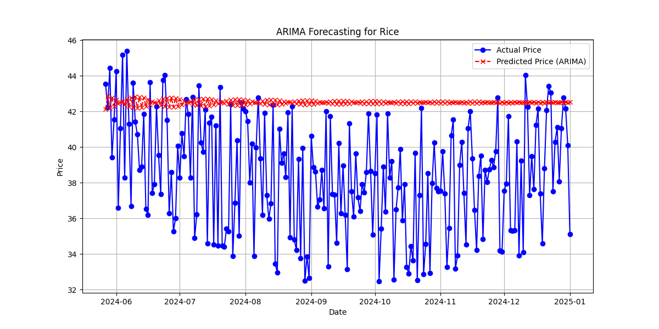
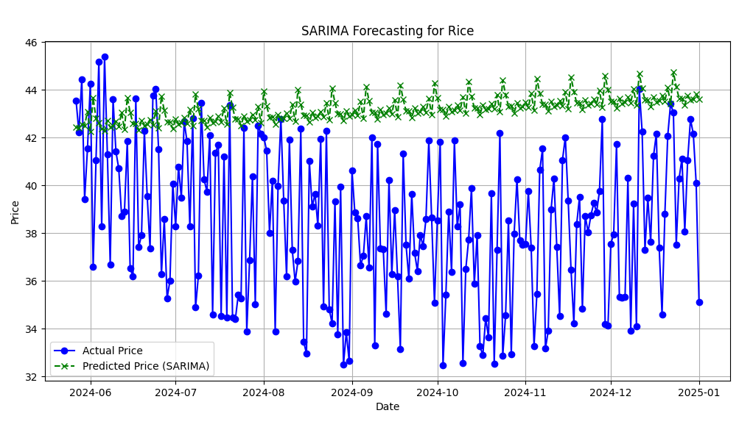
Statistical Models
Selecting the right forecasting model depends on the nature of the data, the complexity of patterns, and the required interpretability.
ARIMA
SARIMA
Auto Regressive Integrated Moving Average: A popular model for linear time series forecasting, effective when data is stationary.
Seasonal ARIMA: An extension of ARIMA that incorporates seasonal components for periodic data.

Slide 8
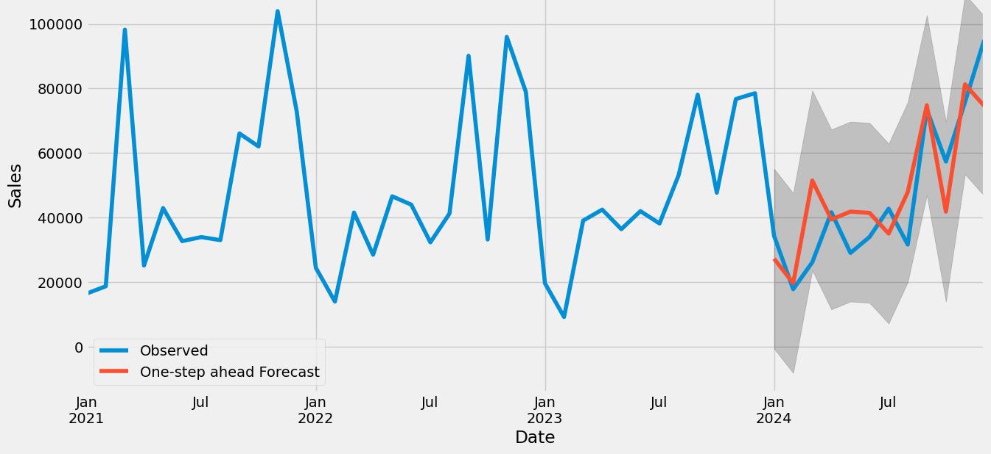
Forecasting & Performance Evaluation
Once the model is validated, it is used to generate one-step-ahead forecasts and compare them with actual sales data. The accuracy of predictions is evaluated using key metrics:
Mean Squared Error (MSE) – Measures the average squared difference between actual and predicted values.
Root Mean Squared Error (RMSE) – Provides a more interpretable error measure by taking the square root of MSE.

Slide 9
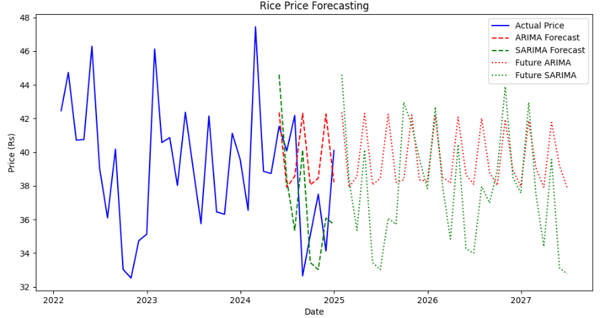
Future Forecasting & Business Applications
The final step is to use the trained SARIMA model for long-term forecasting. In this case, the model is used to predict future sales for the next 65 months, allowing businesses to make informed strategic decisions. These forecasts can help in inventory management, financial planning, marketing strategies, and demand forecasting. By continuously refining the model with new data, businesses can improve forecast accuracy and gain valuable insights into future trends.

Slide 10
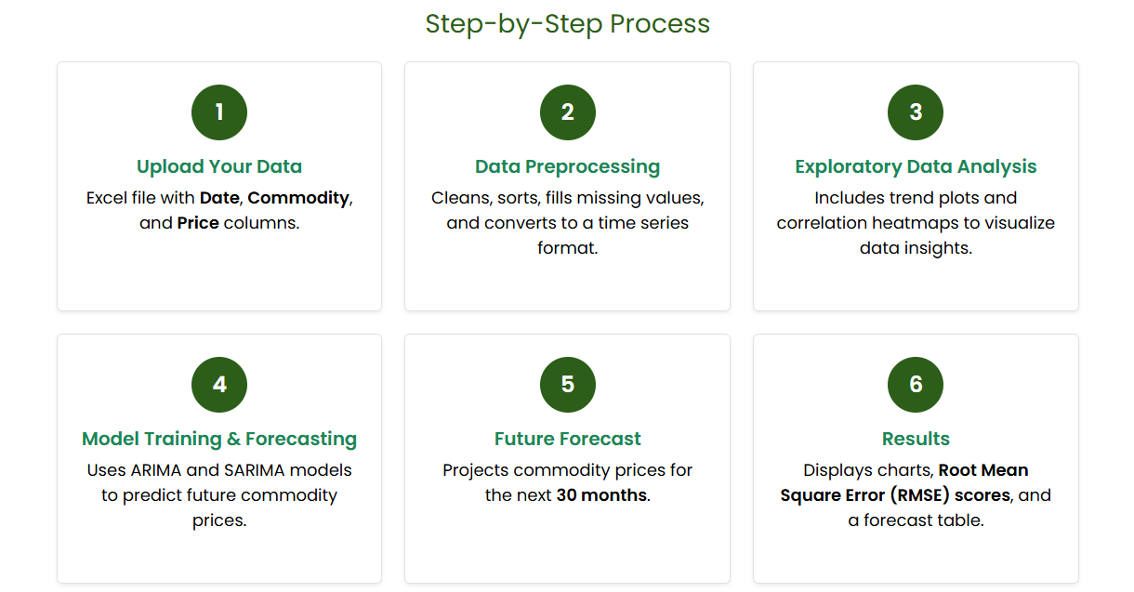

Slide 11
Literature Survey
Overview of Time Series Forecasting
Several studies have applied Time Series Analysis (TSA) methods like ARIMA and SARIMA for forecasting agricultural commodity prices, showing good accuracy in capturing trends and seasonality. Python is widely used in these studies due to its powerful libraries like statsmodels and pmdarima, which make model implementation and evaluation easier. Research highlights that combining historical price data with TSA techniques provides reliable short-term forecasts that support better decision-making in the agriculture sector.

Slide 12
ARIMA and SARIMA in Forecasting Applications
ARIMA in Crop Price Forecasting
Researchers have used ARIMA models to forecast rice prices across different states in India. By analyzing monthly price data, the ARIMA model successfully captured trends and provided short-term price predictions, helping farmers and traders plan market strategies and reduce losses due to price volatility.
SARIMA in Vegetable Price Forecasting
SARIMA models have been applied to forecast tomato prices, which show strong seasonality. By accounting for both seasonal and trend components, SARIMA provided more accurate predictions compared to ARIMA alone, especially during peak harvest and lean seasons, helping in supply chain and storage planning.

Slide 13
Recent Advancements & Hybrid Models
To overcome these challenges, researchers have explored hybrid models that combine ARIMA/SARIMA with machine learning techniques:
2020 – Hybrid ARIMA-ANN Models Researchers began combining ARIMA with Artificial Neural Networks (ANN) to capture both linear and non-linear patterns in price data, improving forecasting accuracy.
2021 – LSTM-based Deep Learning Models Long Short-Term Memory (LSTM) networks gained popularity for capturing long-range dependencies in time series data, outperforming traditional models in volatile commodity markets.
2022 – Ensemble Techniques Studies used ensemble models (e.g., ARIMA + XGBoost) to combine statistical and machine learning approaches, enhancing prediction stability and adaptability to market shocks.

Slide 14
Reference
Ahmed, S., & Wahid, M. (2020). Hybrid ARIMA-ANN model for time series forecasting of agricultural commodity prices. International Journal of Forecasting.
Chakraborty, S., & Ghosh, I. (2021). LSTM-based deep learning approach for agricultural price prediction. Journal of Artificial Intelligence Research.
Patel, H., & Mehta, V. (2022). Ensemble learning models for agricultural market forecasting: A comparative study of ARIMA, XGBoost, and hybrid methods. IEEE Access.
Reddy, K. N., & Sharma, R. (2023). Multivariate time series forecasting using SARIMAX for seasonal crops with weather influence. Computers and Electronics in Agriculture.
Kumar, R., & Verma, P. (2024). Deploying AI-powered forecasting models using Python Django for real-time agricultural analytics. Procedia Computer Science.

Slide 15
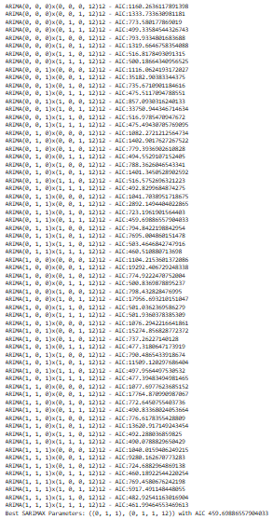
THANK YOU !!!

